Slide 1
JSTL

Slide 2
MVC in JSP
In this module we will see below topics
JSTL

Slide 3
JSTL
JSTL stands for JSP Standard Tag Library. JSTL is the standard tag library that provides tags to control the JSP page behaviour.
JSTL tags can be used for iteration and control statements, internationalization, SQL etc.
JSTL is part of the Java EE API and included in most servlet containers. For using JSTL in our JSP pages, we need to download the JSTL jars for your servlet container. We can find them in the example projects of server download and we can use them most of time. We need to include these libraries in our web application project WEB-INF/lib directory.
JSTL jars
JSTL jars are container specific, for example in Tomcat, we need to include jstl.jar and standard.jar jar files in project build path. If they are not present in the container lib directory, you should include them into your application.
Also If you have maven project, below dependencies should be added in pom.xml file or else you will get following error in JSP pages – eclipse Can not find the tag library descriptor for
http://java.sun.com/jsp/jstl/ core

Slide 4
JSTL
JSTL Tags
Based on the JSTL functions, they are categorized into five types.
1. JSTL Core Tags: JSTL Core tags provide
support for iteration, conditional logic, catch exception, url, forward or redirect response etc.
To use JSTL core tags, we should include it in the JSP page like below.
<%@ taglib uri="http://java.sun.com/jsp/jstl/core" prefix="c" %>
2. JSTL Formatting and Localisation Tags: JSTL Formatting tags are provided
for formatting of Numbers, Dates and i18n support through locales and resource bundles.
We can include these jstl tags in JSP with below syntax:
<%@ taglib uri="http://java.sun.com/jsp/jstl/fmt" prefix="fmt" %>
3. JSTL SQL Tags: JSTL SQL Tags provide
support for interaction with relational databases such as Oracle, MySql etc.
Using JSTL SQL tags we can run database queries, we include these JSTL tags in JSP with below syntax:
<%@ taglib uri="http://java.sun.com/jsp/jstl/sql" prefix="sql" %>

Slide 5
JSTL
4. JSTL XML Tags: JSTL XML tags are used to work with XML documents such as parsing XML, transforming XML data and XPath expressions evaluation. Syntax to include JSTL XML tags in JSP page is:
<%@ taglib uri="http://java.sun.com/jsp/jstl/xml" prefix="x" %>
5. JSTL Functions Tags: JSTL tags provide a number of functions that we can use to perform common operation, most of them are for String manipulation such as String Concatenation, Split String etc. Syntax to include JSTL functions in JSP page is:
<%@ taglib uri="http://java.sun.com/jsp/jstl/functions" prefix="fn" %>

Slide 6
JSTL
JSTL Core Tags are listed in the below table.
JSTL CORE TAG | DESCRIPTION
<c:out> | To write something in JSP page, we can use EL also with this tag
<c:import> | Same as <jsp:include> or include directive
<c:redirect> | redirect request to another resource
<c:set> | To set the variable value in given scope.
<c:remove> | To remove the variable from given scope
<c:catch> | To catch the exception and wrap it into an object.
<c:if> | Simple conditional logic, used with EL and we can use it to process the exception from <c:catch>
<c:choose> | Simple conditional tag that establishes a context for mutually exclusive conditional operations, marked by <c:when> and <c:otherwise>
<c:when> | Subtag of <c:choose> that includes its body if its condition evalutes to ‘true’.
<c:otherwise> | Subtag of <c:choose> that includes its body if its condition evalutes to ‘false’.
<c:forEach> | for iteration over a collection
<c:forTokens> | for iteration over tokens separated by a delimiter.
<c:param> | used with <c:import> to pass parameters
<c:url> | to create a URL with optional query string parameters

Slide 7
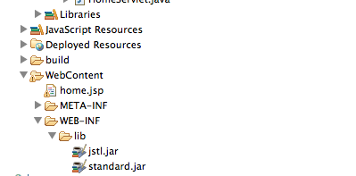
JSTL Example Duration:30 min
In the example below we will include a Java Bean and we will create a list of objects and set some attributes that will be used in the JSP. JSP page will show how to iterate over a collection, using conditional logic with EL and some other common usage.
Create dynamic web project and add jstl.jar and standard.jar file and keep in web-inf/lib folder
Create a package named com.test.model and create a java class Employee

Slide 8
JSTL Example Duration:30 min
HomeServlet.java
package com.test.servlet;
import java.io.IOException;
import java.util.ArrayList;
import java.util.List;
import com.test.model.*;
import javax.servlet.RequestDispatcher;
import javax.servlet.ServletException;
import javax.servlet.annotation.WebServlet;
import javax.servlet.http.HttpServlet;
import javax.servlet.http.HttpServletRequest;
import javax.servlet.http.HttpServletResponse;
@WebServlet("/HomeServlet")
public class HomeServlet extends HttpServlet {
private static final long serialVersionUID = 1L;
protected void doGet(HttpServletRequest request, HttpServletResponse response) throws ServletException, IOException {
List<Employee> empList = new ArrayList<Employee>();
Employee emp1 = new Employee();
emp1.setId(1); emp1.setName("Sujit");emp1.setRole("Architect");
Employee emp2 = new Employee();
emp2.setId(2);
Employee.java
package com.test.model;
public class Employee {
private int id;
private String name;
private String role;
public Employee() {
}
public int getId() {
return id;
}
public void setId(int id) {
this.id = id;
}
public String getName() {
return name;
}
public void setName(String name) {
this.name = name;
}
public String getRole() {
return role;
}
public void setRole(String role) {
this.role = role;
}
}
emp2.setName("Priya");emp2.setRole("Business development Manager");
empList.add(emp1);empList.add(emp2);
request.setAttribute("empList", empList);
request.setAttribute("htmlTagData", "<br/> creates a new line.");
request.setAttribute("url", "https://www.w3school.com");
RequestDispatcher rd = getServletContext().getRequestDispatcher("/JSTLHome.jsp");
rd.forward(request, response);
}

Slide 9
JSTL Example Contd…
JSTLHome.jsp
<%@ page language="java" contentType="text/html; charset=US-ASCII"
pageEncoding="US-ASCII"%>
<%@ taglib uri="http://java.sun.com/jsp/jstl/core" prefix="c" %>
<!DOCTYPE html PUBLIC "-//W3C//DTD HTML 4.01 Transitional//EN" "http://www.w3.org/TR/html4/loose.dtd">
<html>
<head>
<meta http-equiv="Content-Type" content="text/html; charset=US-ASCII">
<title>Home Page</title>
<style>
table,th,td
{
border:1px solid black;
}
</style>
</head>
<body>
<%-- Using JSTL forEach and out to loop a list and display items in table --%>
<table>
<tbody>
<tr><th>ID</th><th>Name</th><th>Role</th></tr>
<c:forEach items="${requestScope.empList}" var="emp">
<tr><td><c:out value="${emp.id}"></c:out></td>
<td><c:out value="${emp.name}"></c:out></td>
<td><c:out value="${emp.role}"></c:out></td></tr>
</c:forEach>
</tbody>
</table>
<br><br>
<%-- simple c:if and c:out example with HTML escaping --%>
<c:if test="${requestScope.htmlTagData ne null }">
<c:out value="${requestScope.htmlTagData}" escapeXml="true"></c:out>
</c:if>
<br><br>
<%-- c:set example to set variable value --%>
<c:set var="id" value="5" scope="request"></c:set>
<c:out value="${requestScope.id }" ></c:out>
<br><br>
<%-- c:catch example --%>
<c:catch var ="exception">
<% int x = 5/0;%>
</c:catch>
<c:if test = "${exception ne null}">
<p>Exception is : ${exception} <br>
Exception Message: ${exception.message}</p>
</c:if>
<br><br>
<%-- c:url example --%>
<a href="<c:url value="${requestScope.url }"></c:url>">Click Here</a>
</body>
</html>

Slide 10
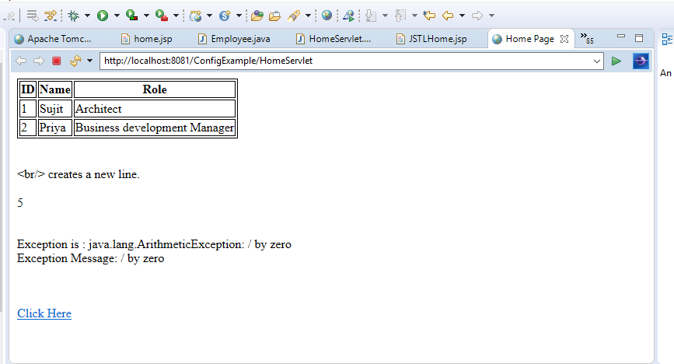
JSTL Example Contd…
Now when we run application with URL http://localhost:8080/JSTLExample/HomeServlet, we get response as in below.

Slide 11

Thank You

